Slide 1
ShAC Management Committee
Presentation to the ShAC
Q1 Meeting - March 27, 2023
Co-Chairs: Jessica Joyce and Amanda Lyons

Slide 2
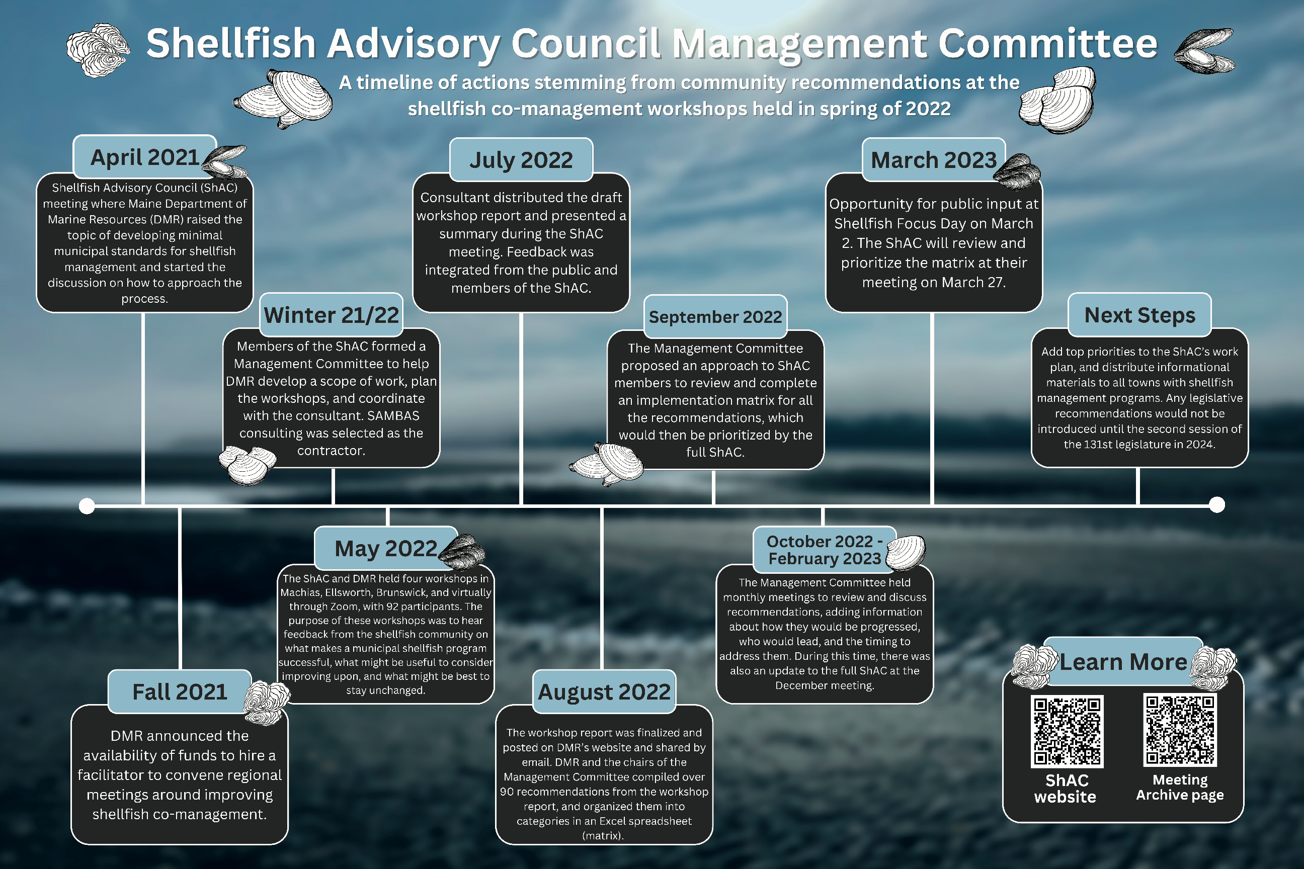
Notes:
Run through timeline and bring poster from SFD!

Slide 3
Process
Prioritize the state-level recommendations
  In-person sticky dot polling
  Online poll for remote participants
  Select top priorities
  Priorities will be added to the ShAC work plan
  Additional committees will likely be formed
Town-level recommendations will be compiled
  Shared separately this spring through .gov delivery and ShAC website

Slide 4
Nine Categories
Shore access
Licensing
Shellfish conservation
Shellfish management
Technical assistance
Data and Management
Enhancing effectiveness of shellfish committees
Water quality
Enforcement
Notes:
We took ALL recommendations that were raised during the spring workshops, over 90, and then selected those that have some state-level involvement. I’m going to review the ~74 remaining recommendations, and hope everyone was able to look at the matrix – tables with additional information on how to implement, who (which agency and/or nonprofit + towns, if applicable), and the time frame (short-, med-, or long-)

Slide 5
Shore Access
Developing a similar program to IF&W “Hunter Access Program” (i.e., book that reviews relevant laws) to share with harvesters upon receiving their state license, or to share with municipal shellfish committees
Create a pamphlet for potential coastal landowners that includes language on promoting harvester access
Create tax break incentives (or more effectively advertise them) for landowners providing harvester access
Create standard language for municipal comprehensive planning that includes preserving harvester access
Generate a fund for shellfish harvesters to draw from to preserve access on a statewide level through small grants
Provide educational opportunities for realtors
Add information about shore access to DMR door tags
Increase availability and use of DMR coastal grants, including working waterfront grants
Incentivize/increase easements on private property to provide more shore access
Inventory shore access points including walk-in locations
Tax the intertidal property owned by upland landowners

Slide 6
Licensing
Creating new pricing for different types of licenses based on age, where seniors (free), juniors (free), 17-18 (cost less), 18-65 (cost the most)
Raise fees (through revising state statute and ordinances) for non-residents to help cover warden salary.
Improve municipal license accessibility
Prioritize areas for commercial diggers, and then determine areas that could be opened for non-residents without impacting commercial harvester livelihoods and be limited to a bushel, or similar amount, or alternatively limited to seasonal access.
Restrict the amount of non-resident municipal licenses held by one individual on a statewide level
Create a new type of license be created for Wabanaki peoples that could allow for “historical territorial commercial harvesting,” rather than a state and/or municipal shellfish license
Standardize residency requirements
Set license numbers based on assessed resource

Slide 7
Conservation
Improve process and timeliness of (DMR and ACOE) permits required for conservation activities
DMR should consider an increase in the state license fee to create a research/management fund for town shellfish programs.
The legislature should create a shellfish license plate to generate funds for municipal shellfish management like other specialty Maine license plates for wildlife, lobster research and the Humane Society.*
Track predator abundance
Evaluation of wild seed transplant activities
Plan and evaluate conservation activities
Provide an assessment of the effectiveness of conservation activities
Increase/support quahog seeding efforts
Develop new supply streams to increase hatchery seed capacity for conservation projects
Re-evaluate, or describe municipal aquaculture leasing responsibility more in terms of liability associated with individual towns
Create a separate permit for municipal LPAs and move process from the DMR Aquaculture Division (This is currently being address by legislation and DMR)
Notes:
* Currently a moratorium on specialty plates through July 2023 while they revise the program.

Slide 8
Management
Evaluate the content of annual shellfish management review reports
Improving information sharing to help with understanding of shellfish regulations
Improve landings data
Provide annual harvest report at finest scale possible
Define shellfish committee structure
Remove the Shellfish Management Program from Bureau of Public Health (BPH)
Improve management of state managed areas (towns without a municipal ordinance)
Repeal regulations defining municipal shellfish jurisdiction to between high water and subtidal (12 MRS §6671) [PL 2017, c. 350, §2 (NEW).] (proposed as LD 1519)
Improve planning for resource management

Slide 9
Technical Assistance
Increase number of DMR area biologists (DMR staff, including staff to support area biologists have since been increased.)
Increase direct communication between shellfish committees and DMR
Provide annual report information to the public
Increase communication on social media (e.g., Facebook, etc) to keep harvesters informed
Public relations effort to help citizens view shellfish fisheries as part of the community v. "other"
Increase regional cooperation in informal ways
Develop handouts for recreational diggers
Promote available management and informational resources on DMR website
Increase shellfish education in local school curriculums

Slide 10
Data and Information
Provide more environmental information on factors such as nutrient levels, temperatures, salinity, river flow measurements, etc. This data can be collected (using standard protocols) from increased measurements during current water quality testing, or providing funds for municipalities to take similar biological measurements.
Provide model language for comprehensive plans
More real-time modeling efforts like Bigelow Lab's PSP forecast
DMR should conduct statewide stock assessments on a regular basis and share the information with municipal shellfish programs.
Increase stock assessment efforts by towns
Define the economic significance of the shellfish industry

Slide 11
Shellfish Committees
Providing resources and training for shellfish committees to learn key skills for running productive meetings
Encourage committee participation from younger harvesters.
Educating shellfish conservation committees on the responsibilities of managing the resource and introducing them to the information and tools to achieve this.
Develop leadership in municipal shellfish programs

Slide 12
Water Quality
Improve coordination between DMR water quality sampling and town efforts
Improve coordination with municipal officials to solve pollution problems
Plan community efforts to improve water quality
Incentivize landowners to maintain septic systems and remove overboard discharges
Educate up-river towns of pollution impacts downstream
Reduce the impact of dredging on shellfish flats
Consider the impacts of contaminants like PFAS from industrial sites on shellfish flats
Towns can conduct independent shoreline sanitation surveys, water testing, and pollution tracking.

Slide 13
Water Quality (con’t)
Training citizens, including harvesters, landowners, and municipal officials, to recognize pollutions sources
Educate citizens, municipal officials, etc. about wildlife and domestic animal waste
Clarity around who to contact/involve regarding pollution issues
Increase involvement of local Code Enforcement Officers (CEOs) in pollution/water quality issues
Establish priority system for reopening flats
Establish guidelines around lab results (especially water quality)
Real-time communication around water testing results

Slide 14
Enforcement
Increase the number of DMR Marine Patrol Officers (MPOs)
Clarify roles between DMR MPOs and municipal wardens

Slide 15
Prioritization
Each ShAC member has 15 sticky dots
Dots may be placed across all 9 categories or only in several categories
All dots have equal weight
Take 5-10 minutes to walk around and place your dots OR
For ShAC members online, please fill out the poll if you haven’t already
Notes:
Then we will reconvene, and likely the Management Committee will meet in April to discuss the list of top priorities.
Questions?

